Slide 1
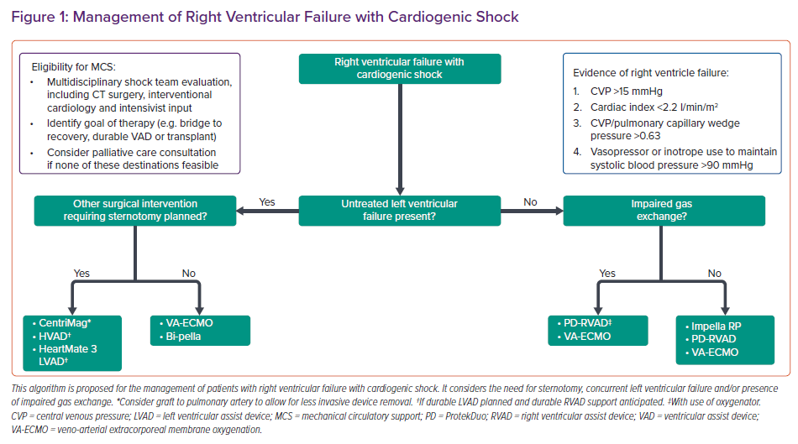
DeFilippis EM, Topkara VK, Kirtane AJ, Takeda K, Naka Y, Garan AR
Management of Right Ventricular Failure with Cardiogenic Shock
Citation: Cardiac Failure Review 2022;8:e14.
https://doi.org/10.15420/cfr.2021.11

