Slide 1
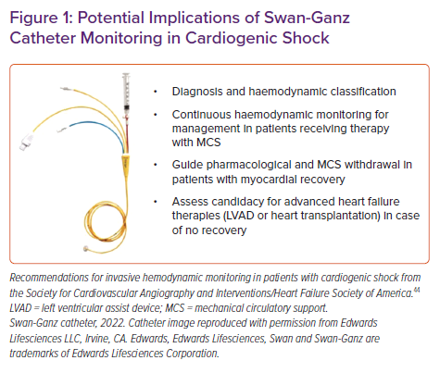
Bertaina M, Galluzzo A, Morici N, Sacco A, Oliva F, Valente S, D’Ascenzo F, Frea S, Sbarra P, Petitti E, Prever SB, Boccuzzi G, Zanini P, Attisani M, Rametta F, Ferrari GMD, Noussan P, Iannaccone M
Potential Implications of Swan-Ganz Catheter Monitoring in Cardiogenic Shock
Citation: Cardiac Failure Review 2022;8:e15.
https://doi.org/10.15420/cfr.2021.32

