Slide 1

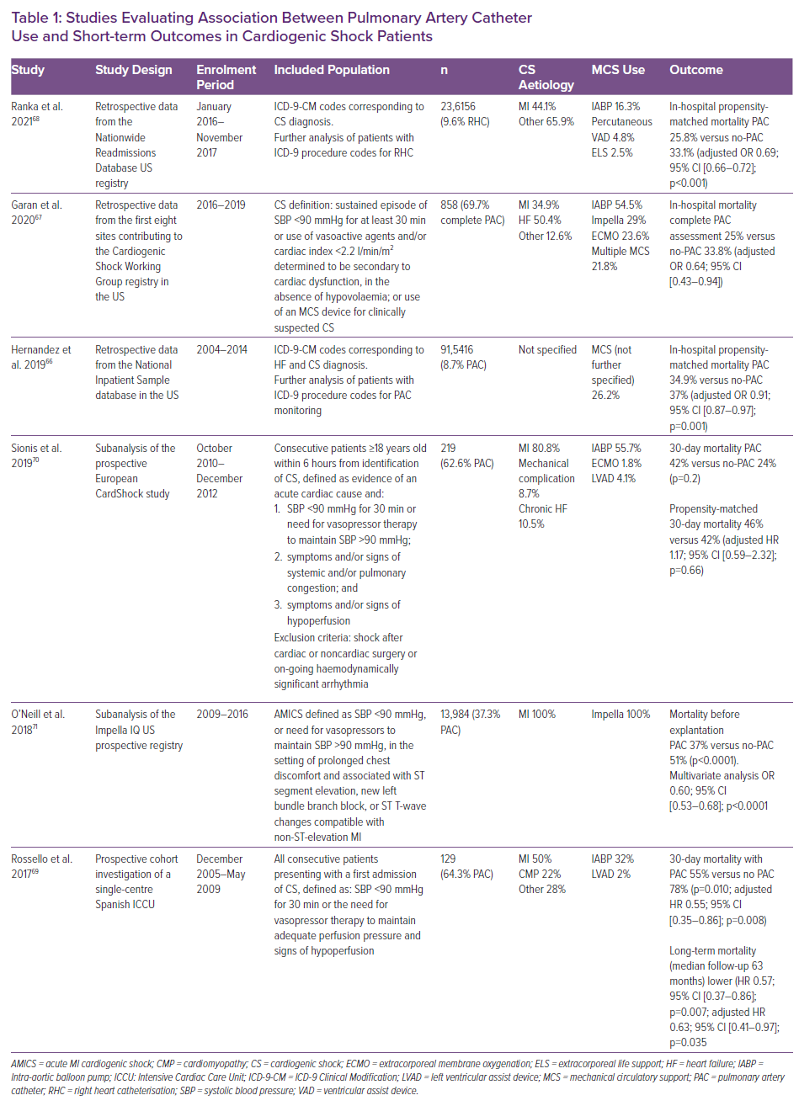
Bertaina M, Galluzzo A, Morici N, Sacco A, Oliva F, Valente S, D’Ascenzo F, Frea S, Sbarra P, Petitti E, Prever SB, Boccuzzi G, Zanini P, Attisani M, Rametta F, Ferrari GMD, Noussan P, Iannaccone M
Studies Evaluating Association Between Pulmonary Artery Catheter Use and Short-term Outcomes in Cardiogenic Shock Patients
Citation: Cardiac Failure Review 2022;8:e15.
https://doi.org/10.15420/cfr.2021.32

