Slide 1
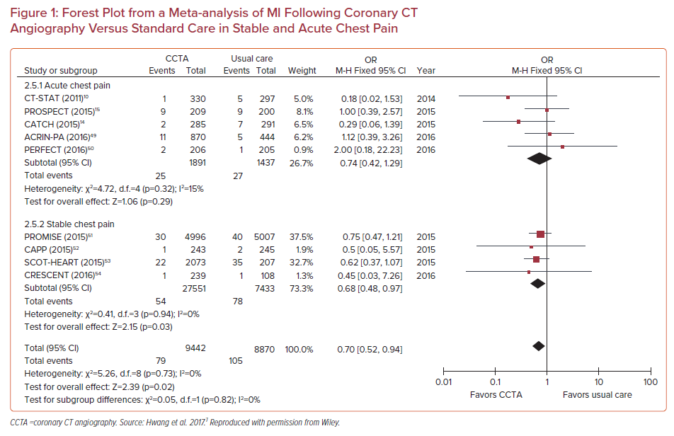
Khawaja T, Janus S, Al-Kindi SG
Forest Plot from a Meta-analysis of MI Following Coronary CT Angiography Versus Standard Care in Stable and Acute Chest Pain
Citation: US Cardiology Review 2022;16:e11.
https://doi.org/10.15420/usc.2021.30

