Slide 1
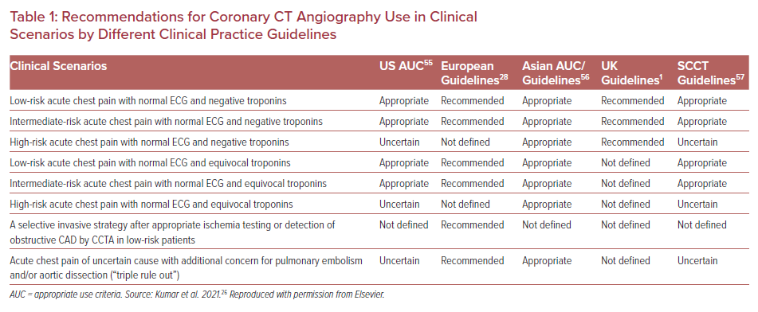
Khawaja T, Janus S, Al-Kindi SG
Recommendations for Coronary CT Angiography Use in Clinical Scenarios by Different Clinical Practice Guidelines
Citation: US Cardiology Review 2022;16:e11.
https://doi.org/10.15420/usc.2021.30

