Slide 1
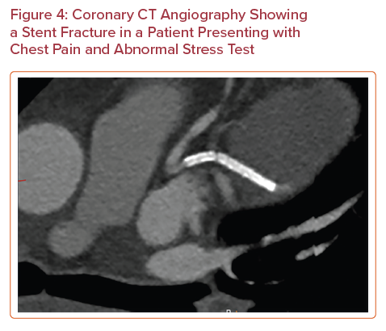
Khawaja T, Janus S, Al-Kindi SG
Coronary CT Angiography Showing a Stent Fracture in a Patient Presenting with Chest Pain and Abnormal Stress Test
Citation: US Cardiology Review 2022;16:e11.
https://doi.org/10.15420/usc.2021.30

