Slide 1
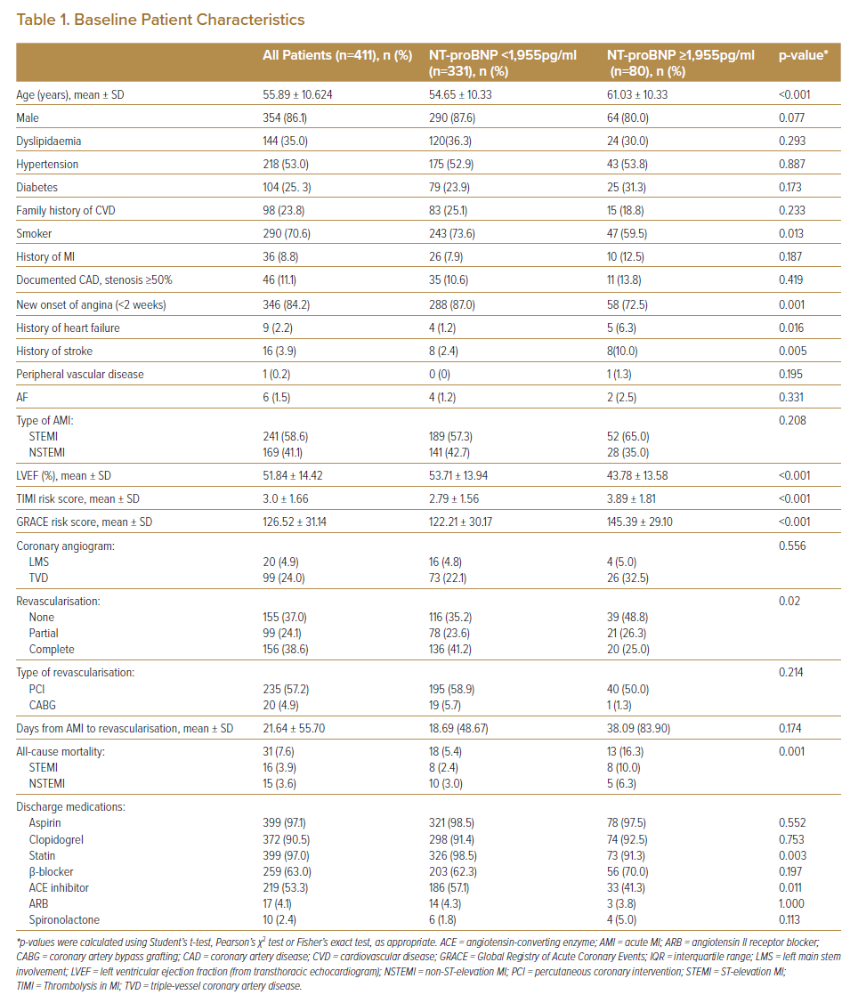
Ning Tan SS, Koh KT, Fong AYY, Bujang MAb, Tiong LL, Cham YL, Ho KH, Tan CT, Khaw CS, Amin NHM, Oon YY, Said A, Lau KT, Yong KY, Pang DCL, Bhavnani CD, Wong IT, Shu FEP, Ong TK
Baseline Patient Characteristics
Citation: Journal of Asian Pacific Society of Cardiology 2022;1:e10.
https://doi.org/10.15420/japsc.2021.14

