Slide 1
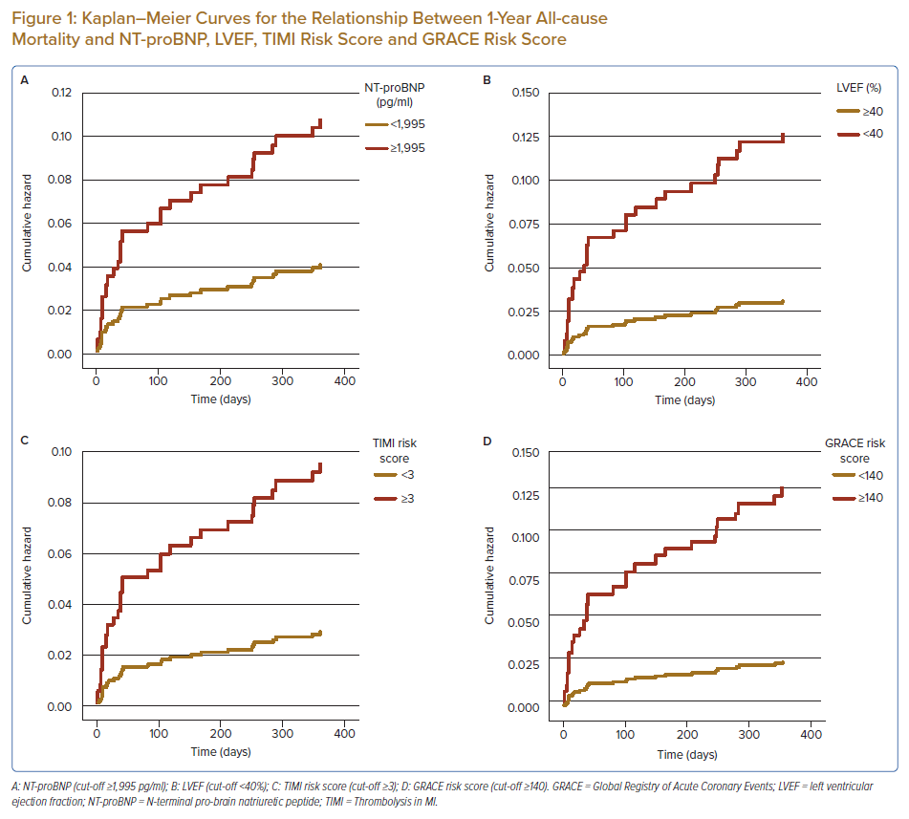
Ning Tan SS, Koh KT, Fong AYY, Bujang MAb, Tiong LL, Cham YL, Ho KH, Tan CT, Khaw CS, Amin NHM, Oon YY, Said A, Lau KT, Yong KY, Pang DCL, Bhavnani CD, Wong IT, Shu FEP, Ong TK
Kaplan–Meier Curves for the Relationship Between 1-Year All-cause Mortality and NT-proBNP, LVEF, TIMI Risk Score and GRACE Risk Score
Citation: Journal of Asian Pacific Society of Cardiology 2022;1:e10.
https://doi.org/10.15420/japsc.2021.14

