Slide 1
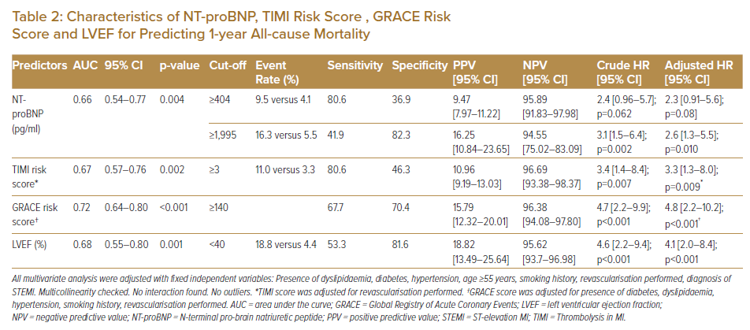
Ning Tan SS, Koh KT, Fong AYY, Bujang MAb, Tiong LL, Cham YL, Ho KH, Tan CT, Khaw CS, Amin NHM, Oon YY, Said A, Lau KT, Yong KY, Pang DCL, Bhavnani CD, Wong IT, Shu FEP, Ong TK
Characteristics of NT-proBNP, TIMI Risk Score , GRACE Risk Score and LVEF for Predicting 1-year All-cause Mortality
Citation: Journal of Asian Pacific Society of Cardiology 2022;1:e10.
https://doi.org/10.15420/japsc.2021.14

