Slide 1
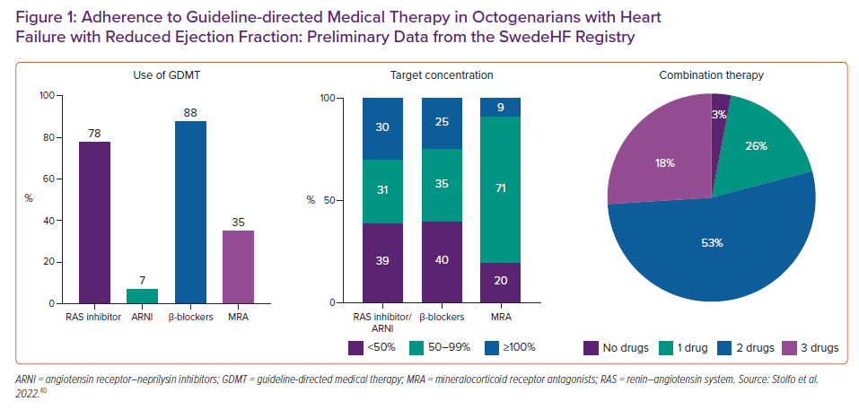
Stolfo D, Sinagra G, Savarese G
Adherence to Guideline-directed Medical Therapy in Octogenarians with Heart Failure with Reduced Ejection Fraction: Preliminary Data from the SwedeHF Registry
Citation: Cardiac Failure Review 2022;8:e16.
https://doi.org/10.15420/cfr.2021.34

