Slide 1
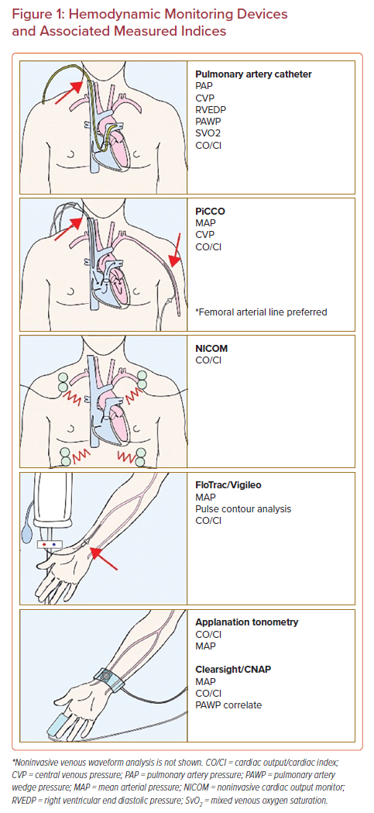
Rali AS, Butcher A, Tedford RJ, Sinha S, Mekki P, Van Spall H, Sauer AJ
Hemodynamic Monitoring Devices and Associated Measured Indices
Citation: US Cardiology Review 2022;16:e12.
https://doi.org/10.15420/usc.2021.34

