Slide 1
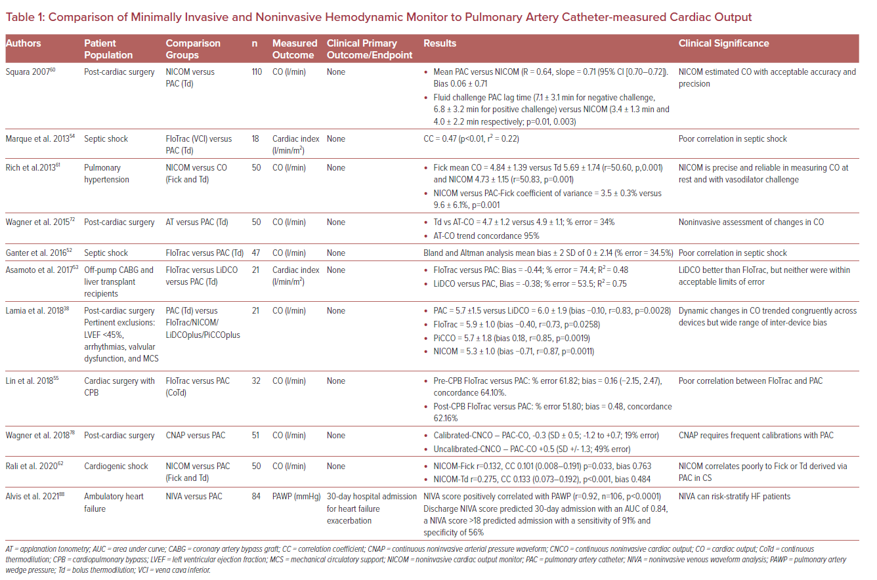
Rali AS, Butcher A, Tedford RJ, Sinha S, Mekki P, Van Spall H, Sauer AJ
Comparison of Minimally Invasive and Noninvasive Hemodynamic Monitor to Pulmonary Artery Catheter-measured Cardiac Output
Citation: US Cardiology Review 2022;16:e12.
https://doi.org/10.15420/usc.2021.34

