Slide 1
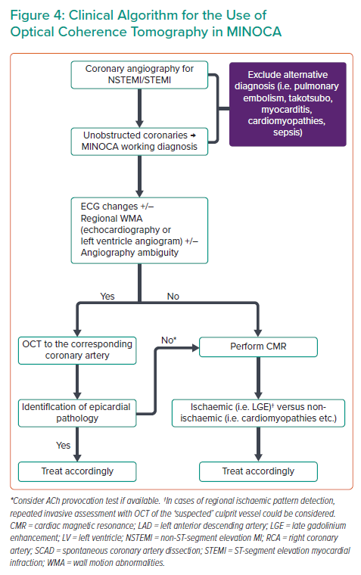
Karamasis GV, Xenogiannis I, Varlamos C, Deftereos S, Alexopoulos D
Clinical Algorithm for the Use of Optical Coherence Tomography in MINOCA
Citation: Interventional Cardiology 2022;17:e06.
https://doi.org/10.15420/icr.2021.31

