Slide 1
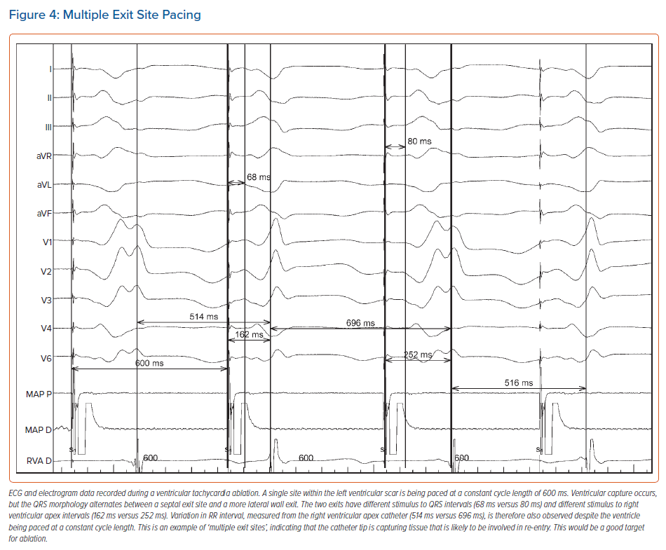
Wiles B, Li AC, Waight MC, Saba M
Multiple Exit Site Pacing
Citation: Arrhythmia & Electrophysiology Review 2022;11:e04.
https://doi.org/10.15420/aer.2021.66

