Slide 1
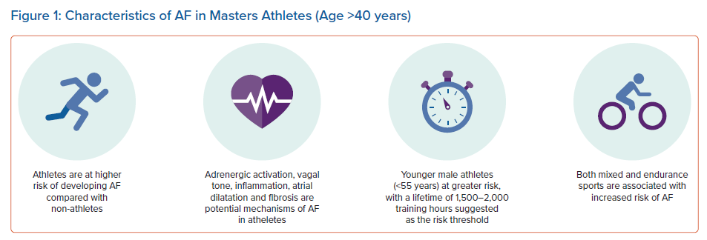
Fyyaz S, Papadakis M
Characteristics of AF in Masters Athletes (Age >40 years)
Citation: Arrhythmia & Electrophysiology Review 2022;11:e05.
https://doi.org/10.15420/aer.2021.68

