Slide 1
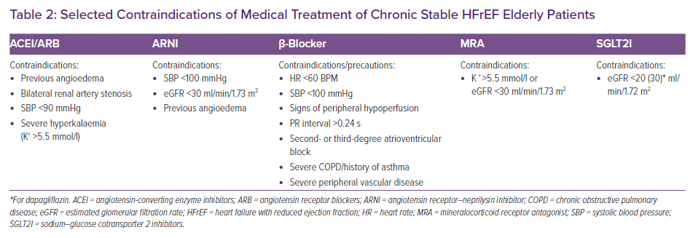
Milinkovic I, Polovina M, Coats AJ, Rosano G, Seferovic PM
Selected Contraindications of Medical Treatment of Chronic Stable HFrEF Elderly Patients
Citation: Cardiac Failure Review 2022;8:e17.
https://doi.org/10.15420/cfr.2021.14

