Slide 1
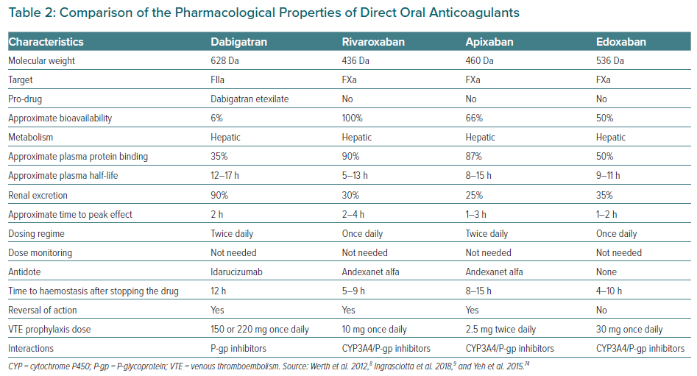
Naung Tun H, Kyaw MT, Rafflenbeul E, López Suástegui X
Comparison of the Pharmacological Properties of Direct Oral Anticoagulants
Citation: European Cardiology Review 2022;17:e11.
https://doi.org/10.15420/ecr.2021.55

