Slide 1
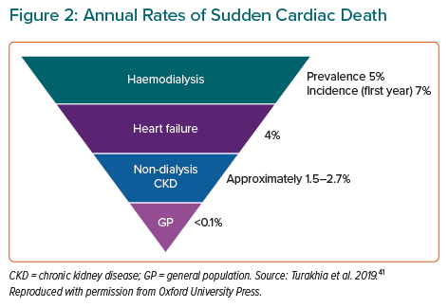
Warrens H, Banerjee D, Herzog CA
Annual Rates of Sudden Cardiac Death
Citation: European Cardiology Review 2022;17:e13.
https://doi.org/10.15420/ecr.2021.54

