Slide 1
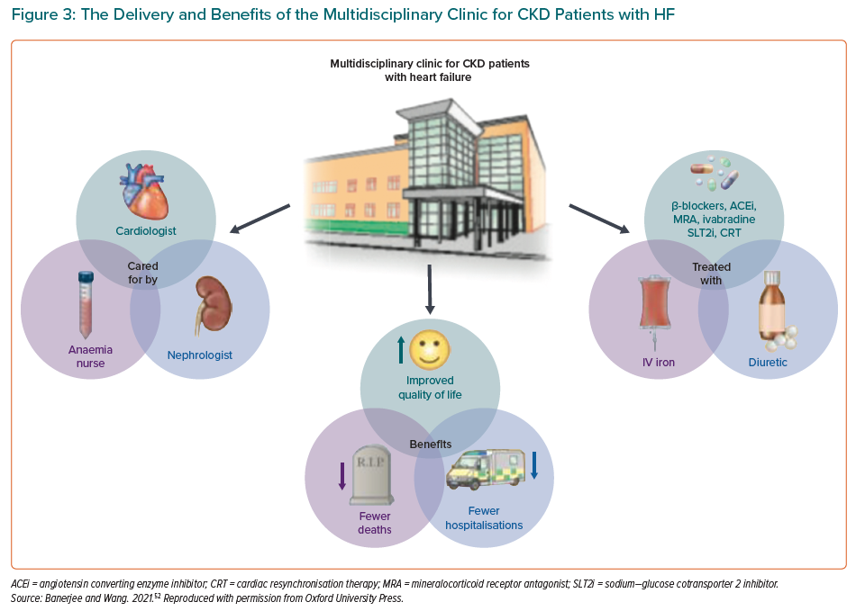
Warrens H, Banerjee D, Herzog CA
The Delivery and Benefits of the Multidisciplinary Clinic for CKD Patients with HF
Citation: European Cardiology Review 2022;17:e13.
https://doi.org/10.15420/ecr.2021.54

