Slide 1
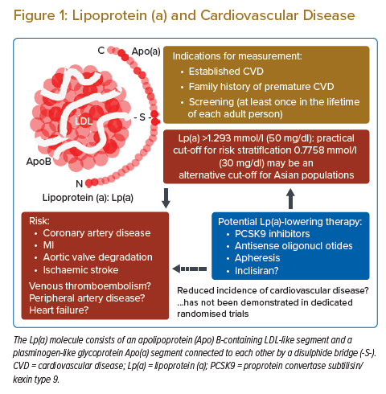
Minami Y, Kinoshita D, Muramatsu Y, Nagata T, Ako J
Lipoprotein (a) and Cardiovascular Disease
Citation: Journal of Asian Pacific Society of Cardiology 2022;1:e11.
https://doi.org/10.15420/japsc.2021.31

