Slide 1

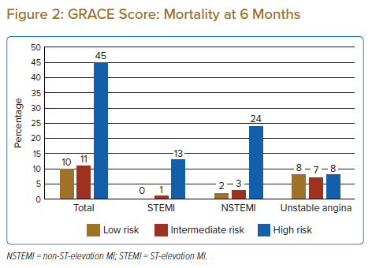
Lim WJ, Ow JK, Cheong XP, Bin Nordin R, Lee CY
GRACE Score: Mortality at 6 Months
Citation: Journal of Asian Pacific Society of Cardiology 2022;1:e12.
https://doi.org/10.15420/japsc.2022.01

