Slide 1
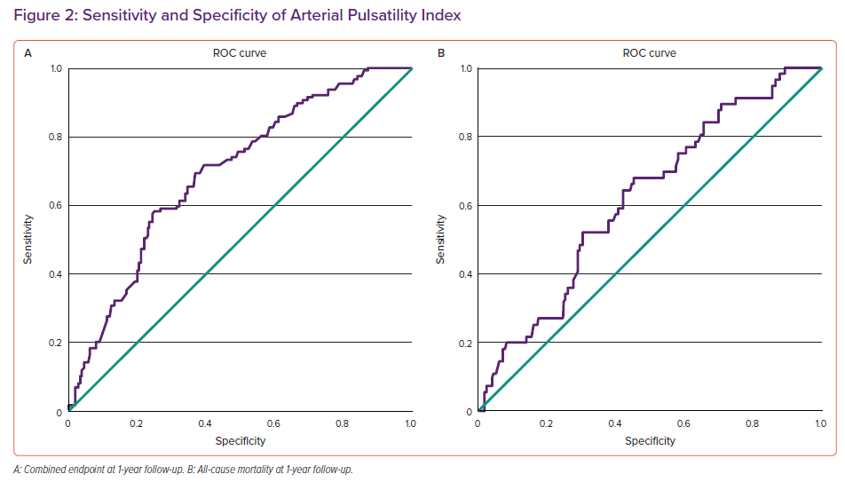
Deis T, Rossing K, Gustafsson F
Sensitivity and Specificity of Arterial Pulsatility Index
Citation: Cardiac Failure Review 2022;8:e18.
https://doi.org/10.15420/cfr.2022.09

