Slide 1
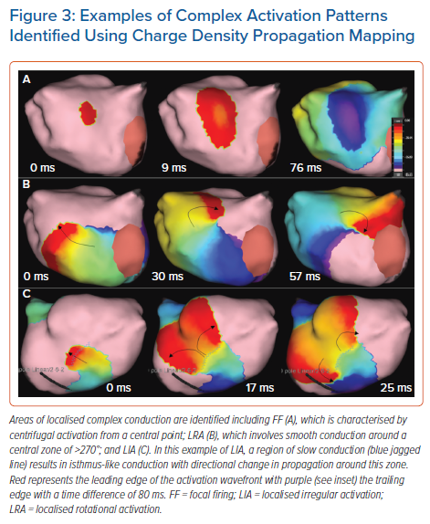
Pope MTB, Betts TR
Examples of Complex Activation Patterns Identified Using Charge Density Propagation Mapping
Citation: Arrhythmia & Electrophysiology Review 2022;11:e06.
https://doi.org/10.15420/aer.2021.64

