Slide 1
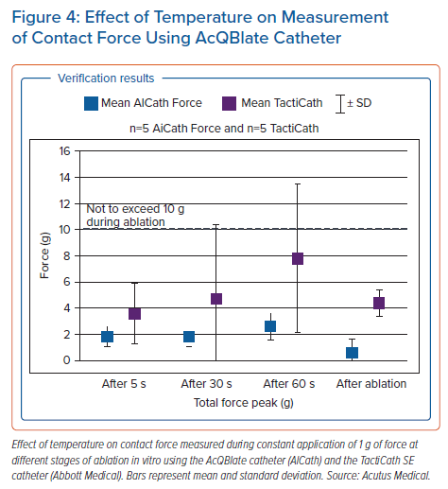
Pope MTB, Betts TR
Effect of Temperature on Measurement of Contact Force Using AcQBlate Catheter
Citation: Arrhythmia & Electrophysiology Review 2022;11:e06.
https://doi.org/10.15420/aer.2021.64

