Slide 1
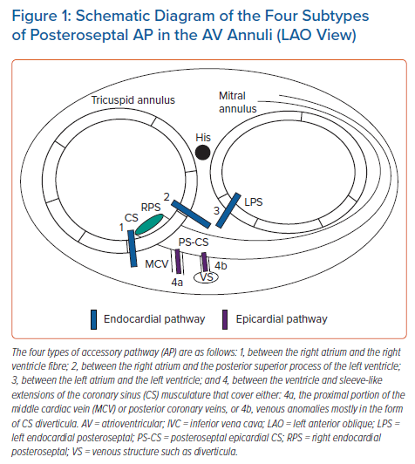
Lebloa M, Pascale P
Schematic Diagram of the Four Subtypes of Posteroseptal AP in the AV Annuli (LAO View)
Citation: Arrhythmia & Electrophysiology Review 2022;11:e07.
https://doi.org/10.15420/aer.2021.55

