Slide 1
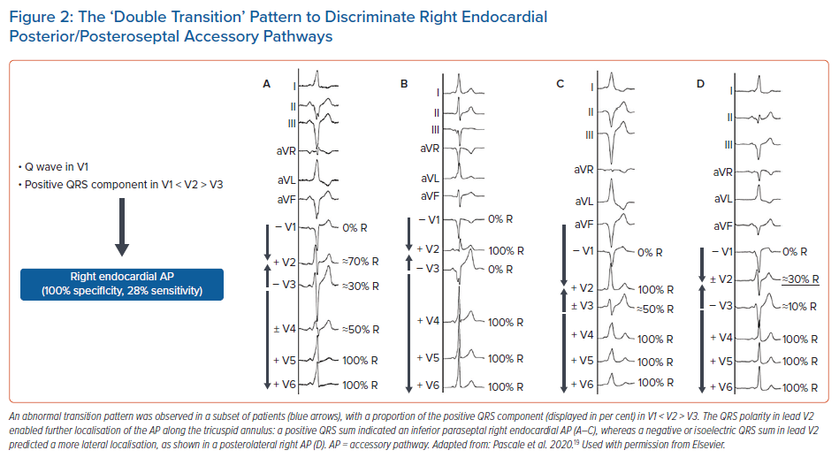
Lebloa M, Pascale P
The ‘Double Transition’ Pattern to Discriminate Right Endocardial Posterior/Posteroseptal Accessory Pathways
Citation: Arrhythmia & Electrophysiology Review 2022;11:e07.
https://doi.org/10.15420/aer.2021.55

