Slide 1
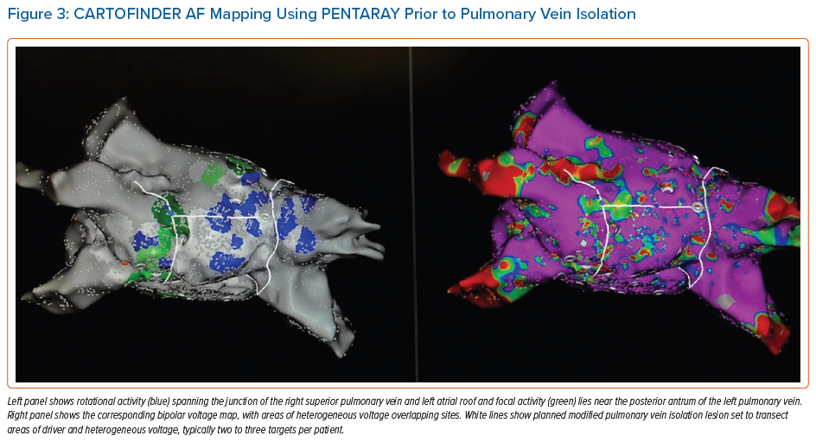
Zaman JA, Grace AA, Narayan SM
CARTOFINDER AF Mapping Using PENTARAY Prior to Pulmonary Vein Isolation
Citation: Arrhythmia & Electrophysiology Review 2022;11:e08.
https://doi.org/10.15420/aer.2021.52

