Slide 1
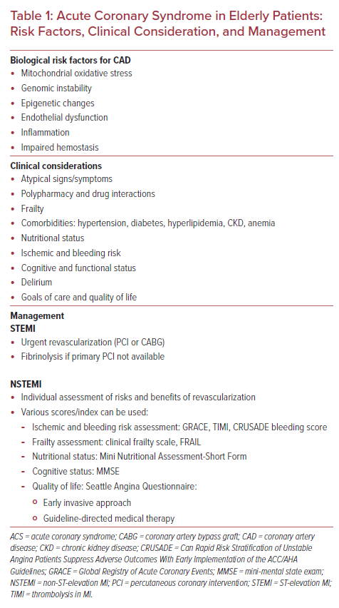
Oberoi M, Ainani N, Abbott JD, Mamas MA, Velagapudi P
Acute Coronary Syndrome in Elderly Patients: Risk Factors, Clinical Consideration, and Management
Citation: US Cardiology Review 2022;16:e14.
https://doi.org/10.15420/usc.2021.29

