Slide 1
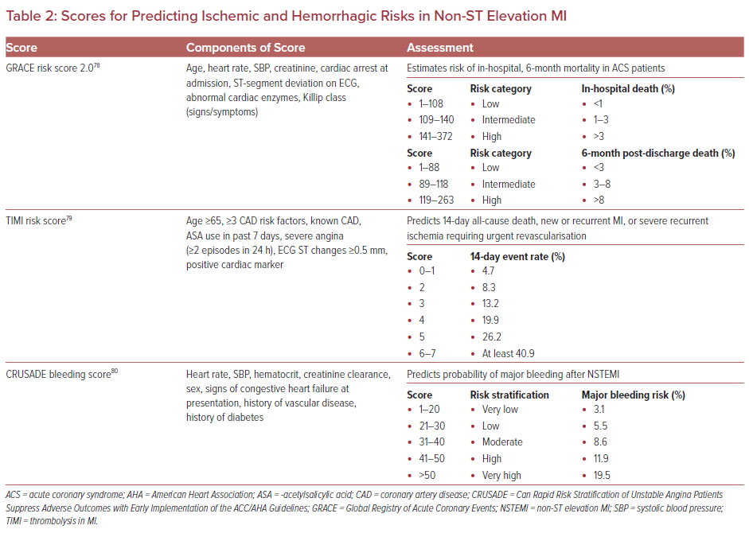
Oberoi M, Ainani N, Abbott JD, Mamas MA, Velagapudi P
Scores for Predicting Ischemic and Hemorrhagic Risks in Non-ST Elevation MI
Citation: US Cardiology Review 2022;16:e14.
https://doi.org/10.15420/usc.2021.29

