Slide 1
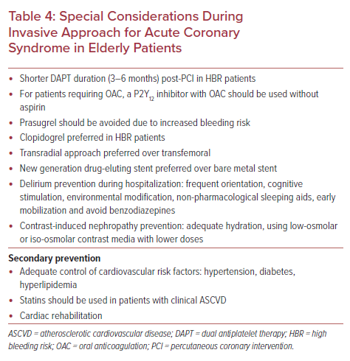
Oberoi M, Ainani N, Abbott JD, Mamas MA, Velagapudi P
Special Considerations During Invasive Approach for Acute Coronary Syndrome in Elderly Patients
Citation: US Cardiology Review 2022;16:e14.
https://doi.org/10.15420/usc.2021.29

