Slide 1
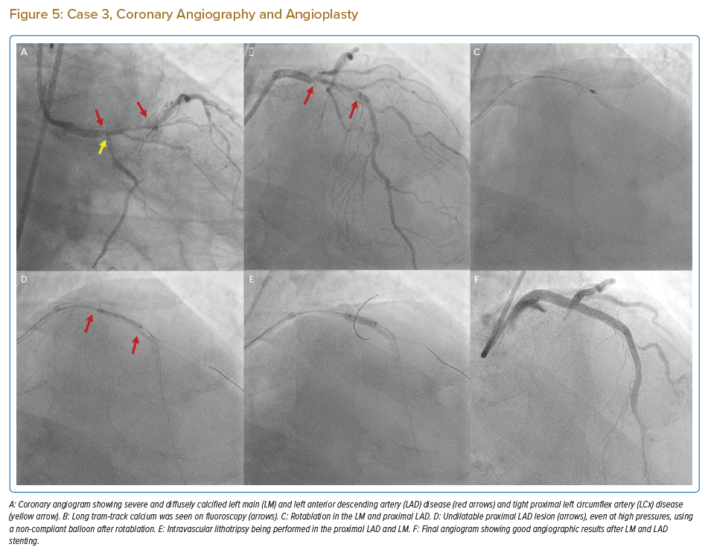
Bootla D, Revaiah PC, Kaur N, Sharma YP, Gupta H
Case 3, Coronary Angiography and Angioplasty
Citation: Journal of Asian Pacific Society of Cardiology 2022;1:e13.
https://doi.org/10.15420/japsc.2021.24

