Slide 1
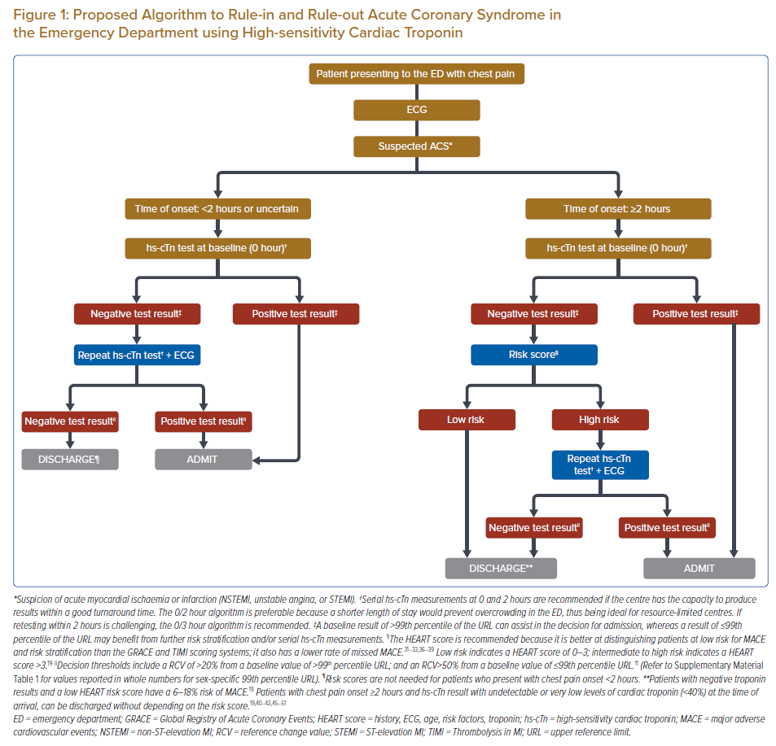
Shariff RER, Kasim SS, Thambiah SC, Osman A, Said A, Jamaluddin FA, Salleh FM, Karim SA
Proposed Algorithm to Rule-in and Rule-out Acute Coronary Syndrome in the Emergency Department using High-sensitivity Cardiac Troponin
Citation: Journal of Asian Pacific Society of Cardiology 2022;1:e14.
https://doi.org/10.15420/japsc.2021.19

