Slide 1
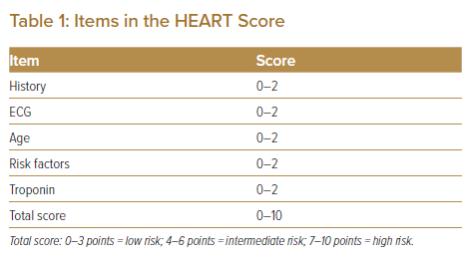
Shariff RER, Kasim SS, Thambiah SC, Osman A, Said A, Jamaluddin FA, Salleh FM, Karim SA
Items in the HEART Score
Citation: Journal of Asian Pacific Society of Cardiology 2022;1:e14.
https://doi.org/10.15420/japsc.2021.19

