Slide 1
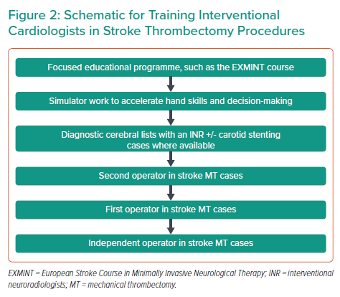
Routledge H, Sharp AS, Kovac J, Westwood M, Keeble TR, Bathula R, Eteiba H, Grunwald IQ, Curzen N
Schematic for Training Interventional Cardiologists in Stroke Thrombectomy Procedures
Citation: Interventional Cardiology 2022;17:e07.
https://doi.org/10.15420/icr.2021.35

