Slide 1
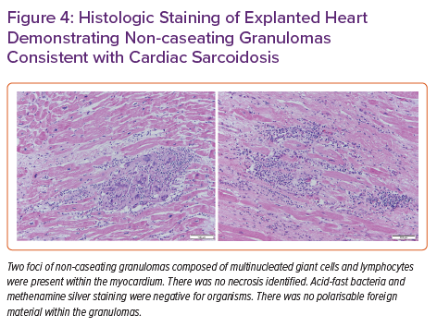
Kumar AA, Tran LE, Rali AS, Perez A, Hoffman R, Schlendorf KH
Histologic Staining of Explanted Heart Demonstrating Non-caseating Granulomas Consistent with Cardiac Sarcoidosis
Citation: Cardiac Failure Review 2022;8:e19.
https://doi.org/10.15420/cfr.2022.05

