Slide 1
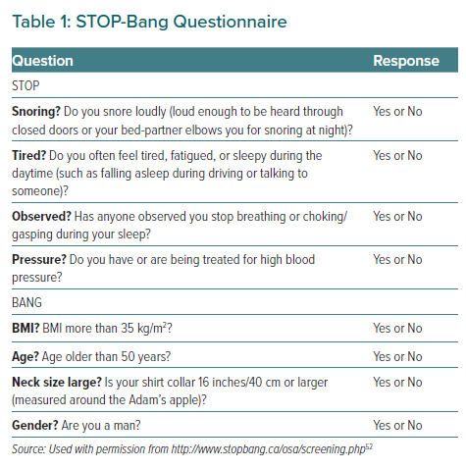
Tan JW, Leow LC, Wong S, Khoo SM, Kasai T, Kojodjojo P, Sy DQ, Lee CP, Chirakalwasan N, Li HY, Koh N, Tan A, Ong TH, Aung AT, Toh ST, Lee CH
STOP-Bang Questionnaire
Citation: European Cardiology Review 2022;17:e16.
https://doi.org/10.15420/ecr.2021.59

