Slide 1
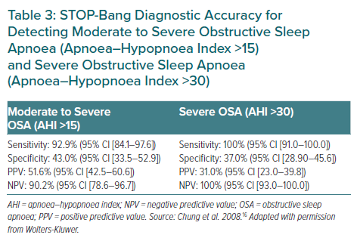
Tan JW, Leow LC, Wong S, Khoo SM, Kasai T, Kojodjojo P, Sy DQ, Lee CP, Chirakalwasan N, Li HY, Koh N, Tan A, Ong TH, Aung AT, Toh ST, Lee CH
STOP-Bang Diagnostic Accuracy for Detecting Moderate to Severe Obstructive Sleep Apnoea (Apnoea–Hypopnoea Index >15) and Severe Obstructive Sleep Apnoea (Apnoea–Hypopnoea Index >30)
Citation: European Cardiology Review 2022;17:e16.
https://doi.org/10.15420/ecr.2021.59

