Slide 1
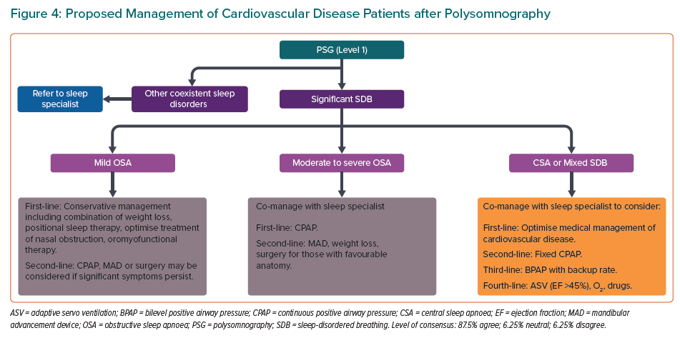
Tan JW, Leow LC, Wong S, Khoo SM, Kasai T, Kojodjojo P, Sy DQ, Lee CP, Chirakalwasan N, Li HY, Koh N, Tan A, Ong TH, Aung AT, Toh ST, Lee CH
Proposed Management of Cardiovascular Disease Patients after Polysomnography
Citation: European Cardiology Review 2022;17:e16.
https://doi.org/10.15420/ecr.2021.59

