Slide 1
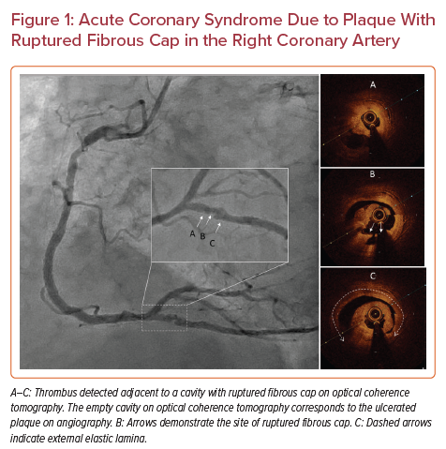
Petrossian G, Ozdemir D, Galougahi KK, Scheiner J, Thomas SV, Shlofmitz RA, Shlofmitz E, Jeremias A, Ali ZA
Acute Coronary Syndrome Due to Plaque With Ruptured Fibrous Cap in the Right Coronary Artery
Citation: US Cardiology Review 2022;16:e15.
https://doi.org/10.15420/usc.2022.03

