Slide 1
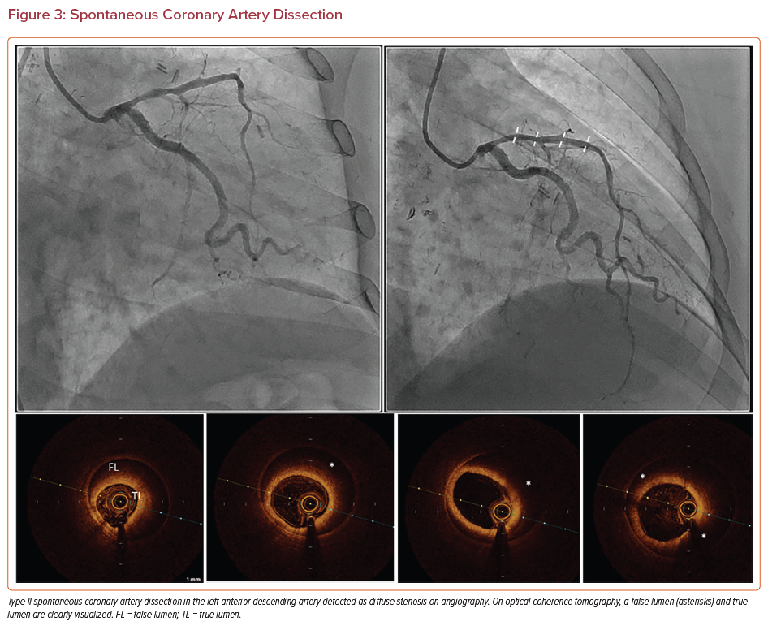
Petrossian G, Ozdemir D, Galougahi KK, Scheiner J, Thomas SV, Shlofmitz RA, Shlofmitz E, Jeremias A, Ali ZA
Spontaneous Coronary Artery Dissection
Citation: US Cardiology Review 2022;16:e15.
https://doi.org/10.15420/usc.2022.03

