Slide 1
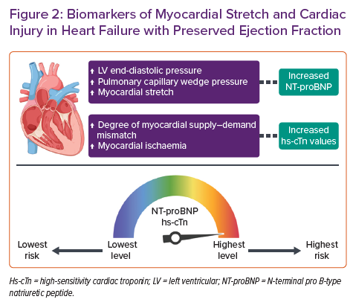
Bayés-Genís A, Cediel G, Domingo M, Codina P, Santiago-Vacas E, Lupón J
Biomarkers of Myocardial Stretch and Cardiac Injury in Heart Failure with Preserved Ejection Fraction
Citation: Cardiac Failure Review 2022;8:e20.
https://doi.org/10.15420/cfr.2021.37

