Slide 1
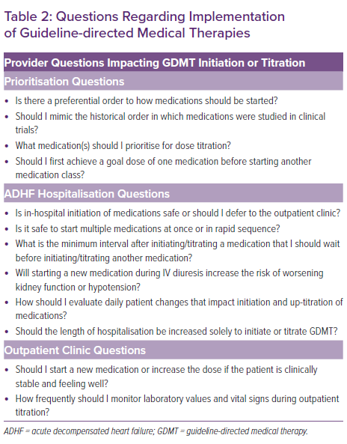
Cox ZL, Nandkeolyar S, Johnson AJ, Lindenfeld J, Rali AS
Questions Regarding Implementation of Guideline-directed Medical Therapies
Citation: Cardiac Failure Review 2022;8:e21.
https://doi.org/10.15420/cfr.2022.08

