Slide 1
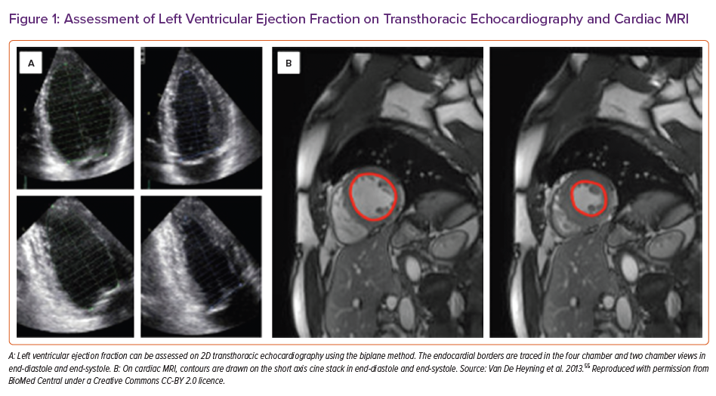
Gosling RC, Al-Mohammad A
Assessment of Left Ventricular Ejection Fraction on Transthoracic Echocardiography and Cardiac MRI
Citation: Cardiac Failure Review 2022;8:e22.
https://doi.org/10.15420/cfr.2021.33

