Slide 1
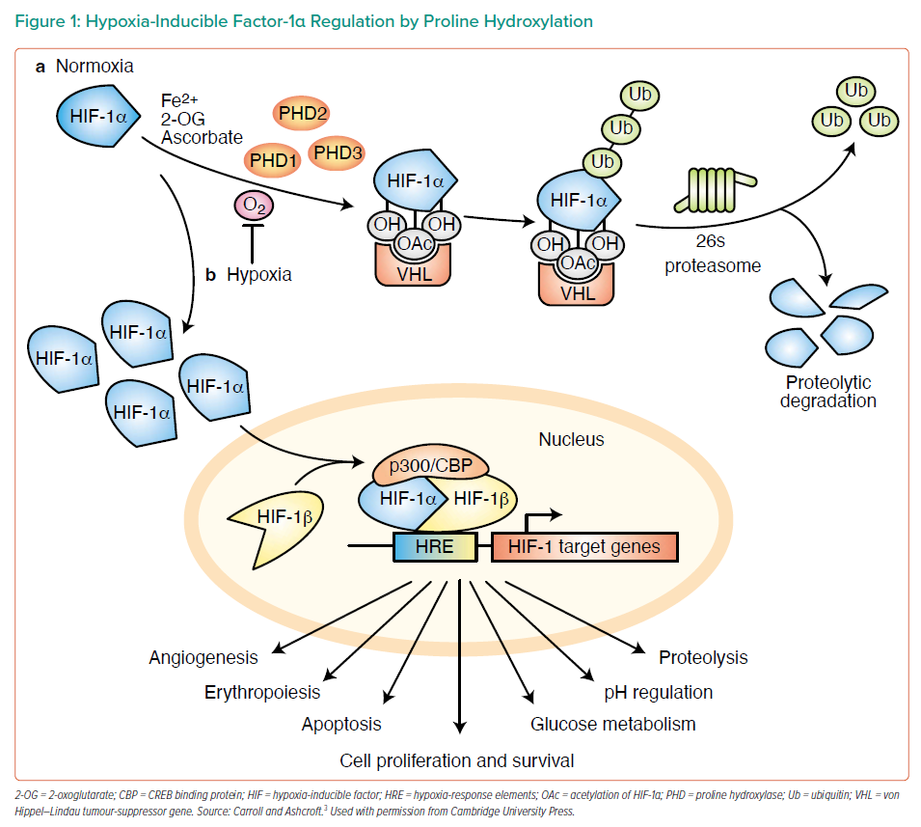
Swain L
Hypoxia-Inducible Factor-1α Regulation by Proline Hydroxylation
Citation: Interventional Cardiology Review 2022;17(Suppl 1):6–7.
https://doi.org/10.15420/icr.2022.17.S1

