Slide 1
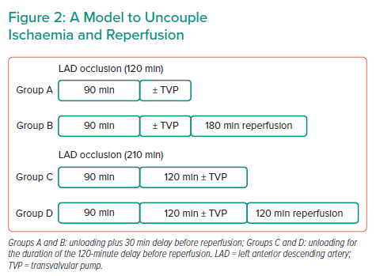
Swain L
A Model to Uncouple Ischaemia and Reperfusion
Citation: Interventional Cardiology Review 2022;17(Suppl 1):6–7.
https://doi.org/10.15420/icr.2022.17.S1

