Slide 1
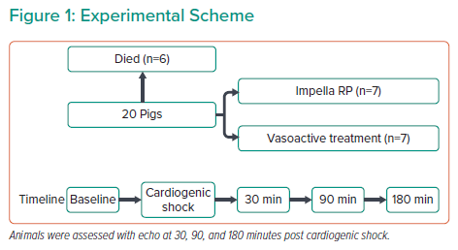
Frederiksen P
Experimental Scheme
Citation: Interventional Cardiology Review 2022;17(Suppl 1):8.
https://doi.org/10.15420/icr.2022.17.S1

