Slide 1
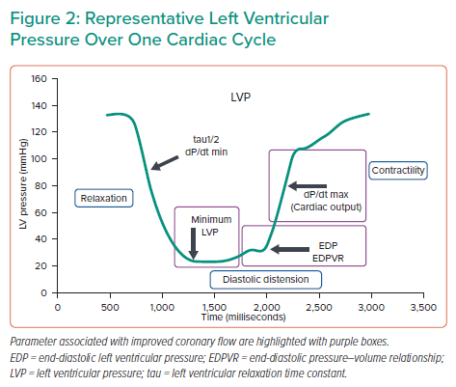
Sakata T
Representative Left Ventricular Pressure Over One Cardiac Cycle
Citation: Interventional Cardiology Review 2022;17(Suppl 1):9–10.
https://doi.org/10.15420/icr.2022.17.S1

