Slide 1
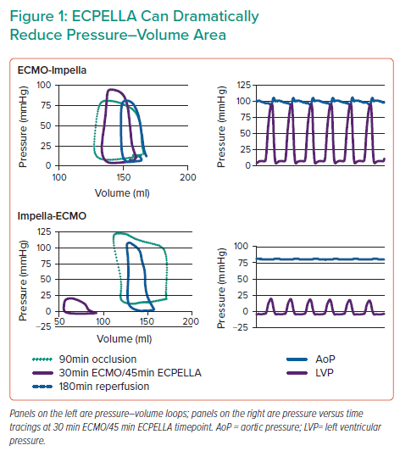
Everett K
ECPELLA Can Dramatically Reduce Pressure–Volume Area
Citation: Interventional Cardiology Review 2022;17(Suppl 1):11.
https://doi.org/10.15420/icr.2022.17.S1

