Slide 1
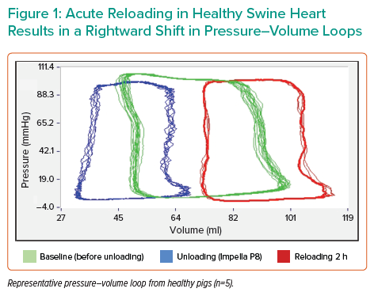
Mazurek R
Acute Reloading in Healthy Swine Heart Results in a Rightward Shift in Pressure–Volume Loops
Citation: Interventional Cardiology Review 2022;17(Suppl 1):12.
https://doi.org/10.15420/icr.2022.17.S1

