Slide 1
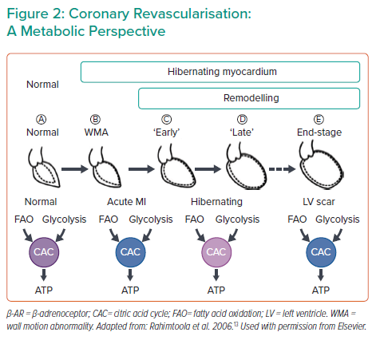
Kapur NK
Coronary Revascularisation: A Metabolic Perspective
Citation: Interventional Cardiology Review 2022;17(Suppl 1):13–5.
https://doi.org/10.15420/icr.2022.17.S1

